Slide 1
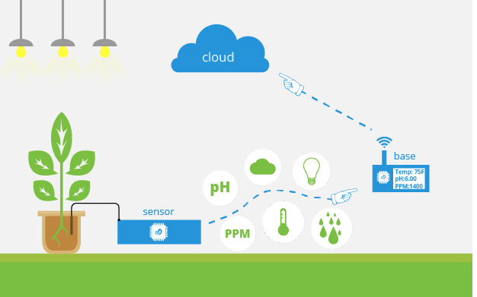
AGROLOGY

Slide 2
Introduction
India’s population is estimated 1.37 billion in 2019.
So the Balance between the optimum population growth and a healthy of nation is far to be achieved
Agriculture is the most important sector of Indian Economy.
Indian agriculture accounts for 18 percent of India’s gross domestic product and provides employment to 50% of the countries workforce.
Nearly 60% of the water used in irrigation is wasted.
Irrigated agriculture has been important source increased agricultural production.

Slide 3
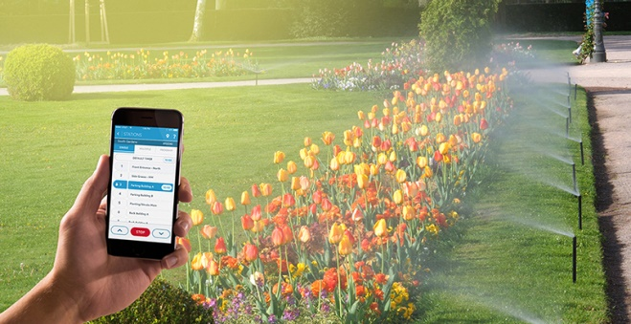
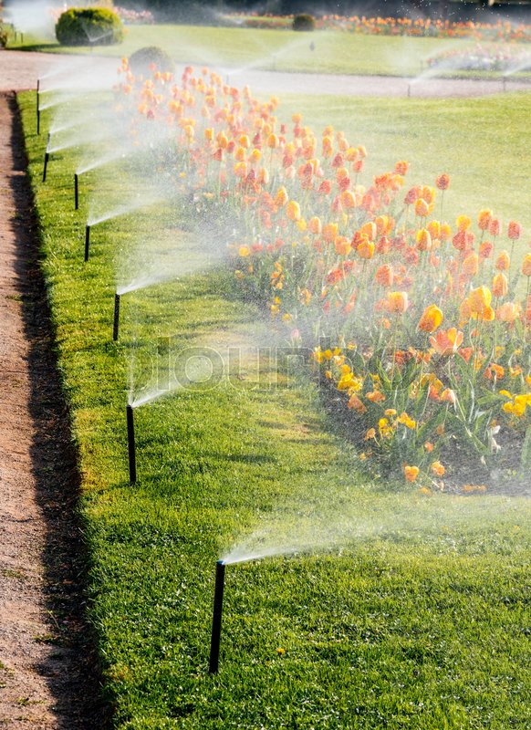
Objectives
To save water and reduce human intervention in the agriculture field.
Continuously monitoring the status of soil through sensors and provide signal for taking necessary action.
To get the output of the sensor and provide water to crop.
To observe parameters for better yield.

Slide 4
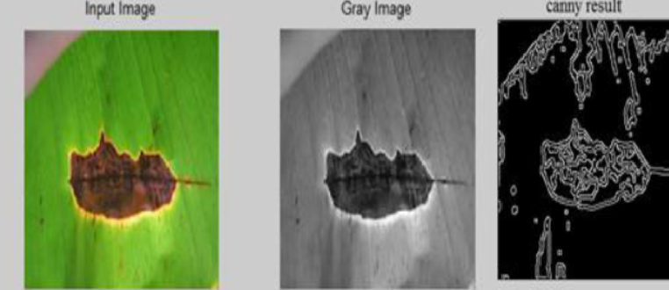
How Artificial intelligence and agriculture technique can be combined for better outputs
Plant growth monitoring
Disease detection
Insect alert
Plants bread detection

Slide 5
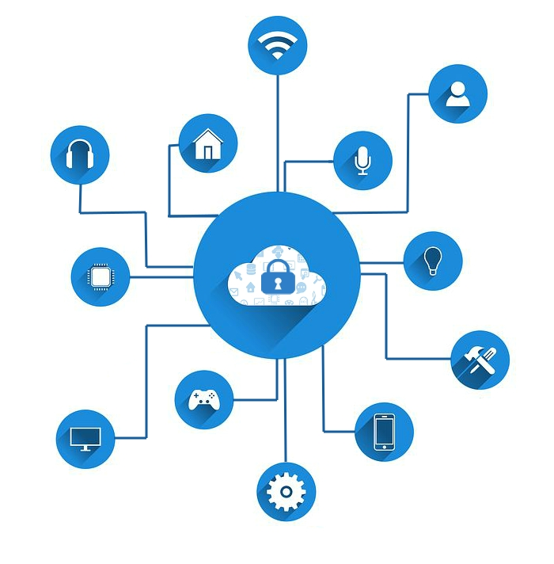
IOT ( Internet of Things ) :
The Internet of Things (IOT) is the inter-networking of “physical devices” also referred to as “connected device” and “smart devices”.
Sometimes referred to as the Internet of Everything ( IOE) and Machine to Machine (M2M) communicating.
IOT is expected to offer advanced connectivity of devices, systems, and services that covers a variety of protocols, domains and application

Slide 6
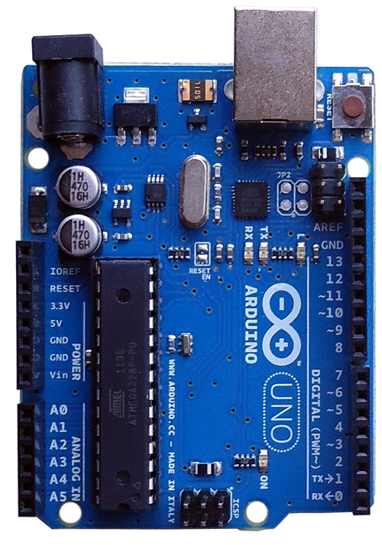
System Component : Hardware and Software
Arduino : It is an open-source platform based on easy-to-use hardware and software.
Hardware : Arduino
Arduino board designs use a variety of microprocessors and controllers in system.
To read inputs – light on a sensor
To twitter message – and turn it into an output - activating a motor

Slide 7
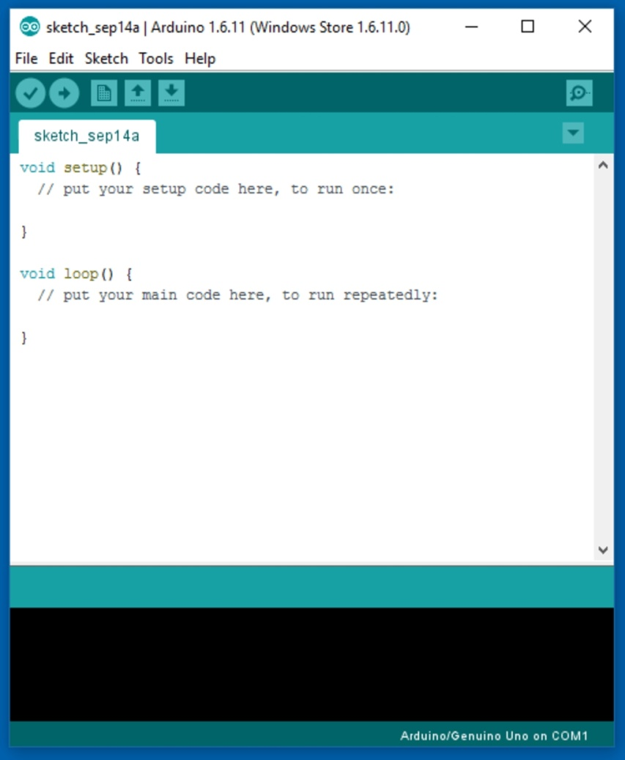
Software:- Arduino ( IDE = Integrated Development Environment)
Use: Check Conditions:
Writing Sketches: Programs written using Arduino Software(IDE) are called sketches.
Upload: Compiles your code and uploads it to the configured board.
New: Creates a new sketch.
Save: Saves your sketch.
Serial Monitor: File, Edit, Sketch, Tools, Help

Slide 8
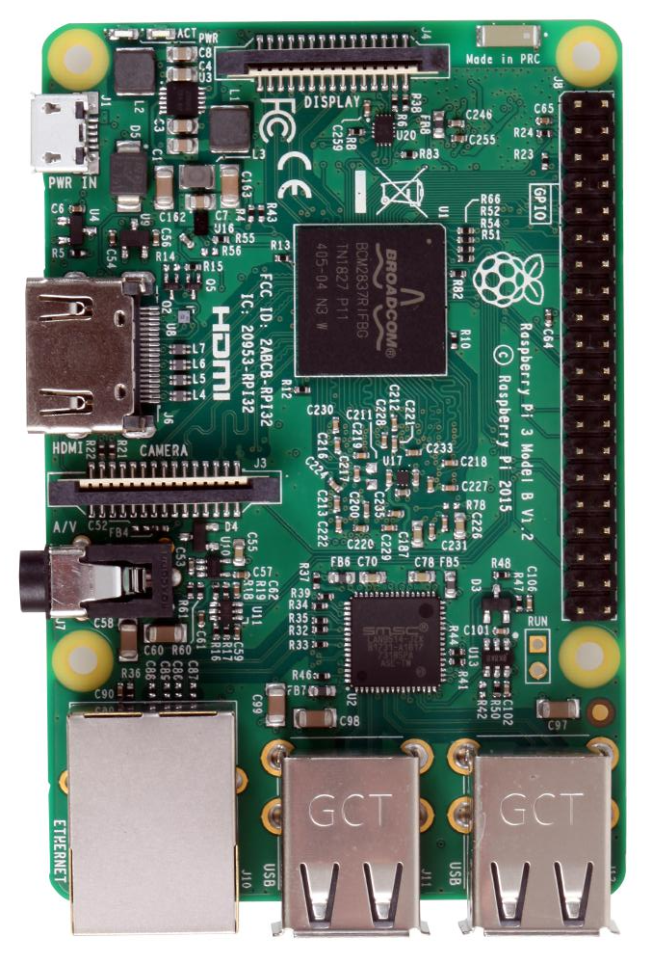
Raspberry pi 3
This is a small, powerful and lightweight microcomputer which can do many of the things that a desktop PC can do.
it does not feature a built- in hard disk or solid – state drive.
It is portable and very cheapest devices or minicomputer just like microcontroller.

Slide 9
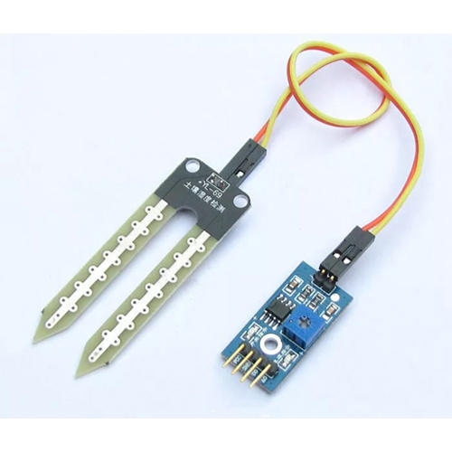
Soil Moisture sensor
Use: To measure the moisture control of the soil
Copper electrodes: Used to sense the moisture content of soil.
The output is connected to a microcontroller

Slide 10
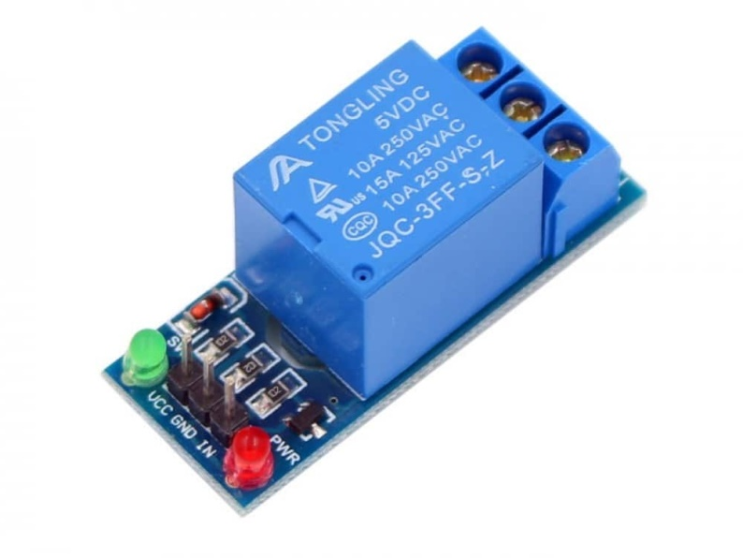
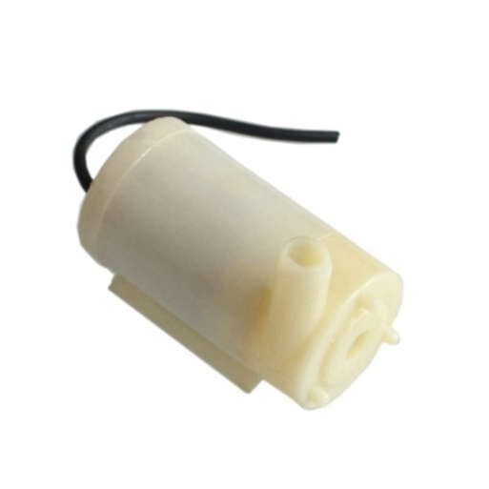
Relay Switch
Relays are switches that open and close Motors Based on Command of Arduino.
In a basic relay there are three contractors:
normally open(NO), normally closed(NC) and common(COM). At ON input state,the COM is connected to NC.
Submersible Motor Pump
A submersible pump is for water lifting.
Motor is connected to a battery via Arduino

Slide 11
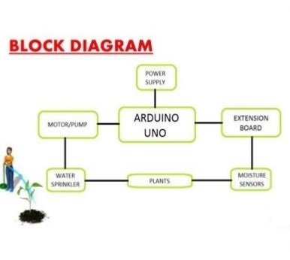
System Hardware Design

Slide 12
Advantages
Water Conservation
Real-Time Data Analysis
Lowered Operation Costs
Efficient and Saves Time
Increase in Productivity
Reduce soil erosion and nutrient leaching

Slide 13
Conclusion
The smart irrigation system is feasible and cost effective.
The irrigation system allows cultivation in places with water security thereby improving sustainability
It proves that the use of water can be diminished.

Slide 14
Submitted by
Rakshit Patel
Azad Singh
Piyush Bisen
Arpit Pandey

